Slide 1
GameMaster Guide
30-Day Partnership Proposal for Meepleville Board Game Cafe
Las Vegas, Nevada | March 2026
Prepared by Tim Pham | tim@playgmg.com

Slide 2
The Challenge
01
Teaching Bottleneck
With 2,600+ games, staff can't teach them all. Customers pick the same 10 games they already know, leaving 95% of your library collecting dust.
02
Game Finder Pain
Staff look up games in Google Sheets to check availability and shelf location. Manual, slow, and breaks the customer experience.
03
Missed Revenue
Customers leave the table to order at the counter, breaking game flow. Some skip ordering entirely rather than interrupt their game.
GameMaster Guide | playgmai.com | tim@playgmg.com
2

Slide 3
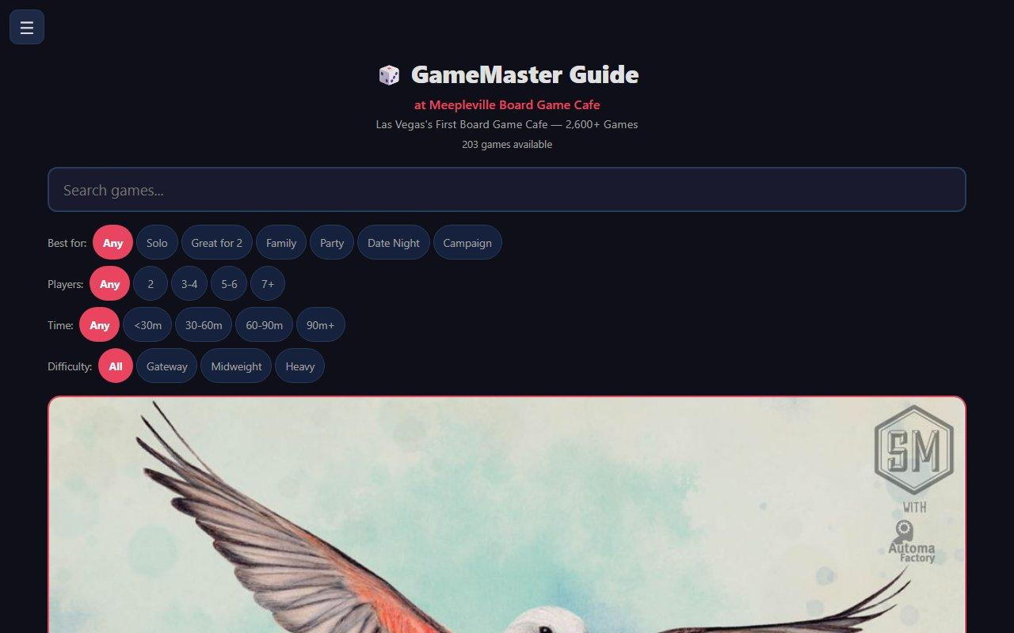
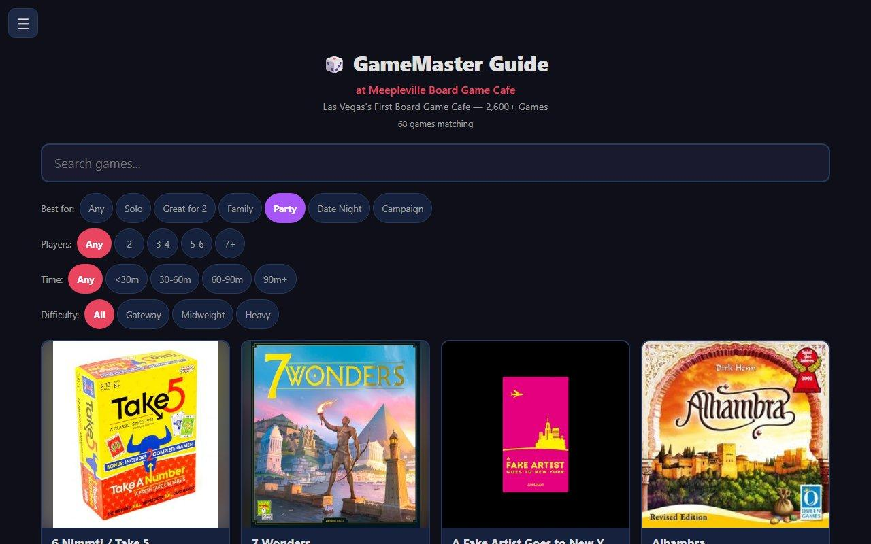
Your Full Library, On Every Phone
+200 games searchable by category, player count, time, and difficulty
Customers find exactly what they're looking for in seconds.
203
6
< 5s
Games
Filters
To Find
GameMaster Guide | playgmai.com | tim@playgmg.com
3

Slide 4
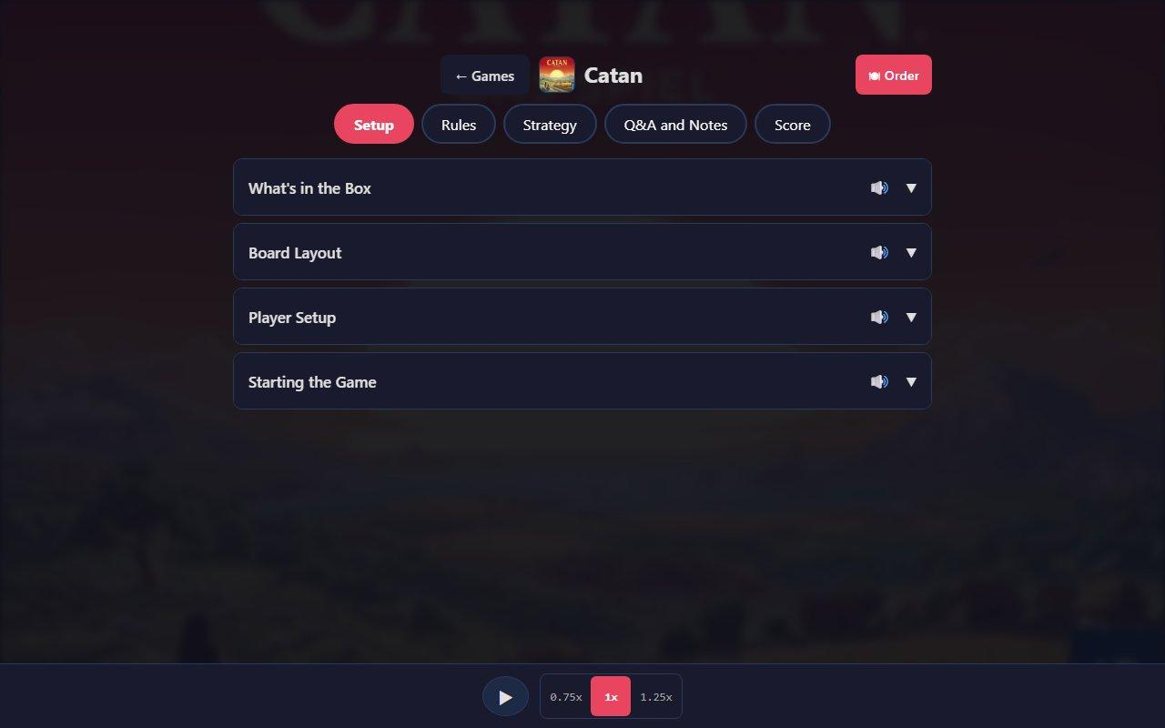
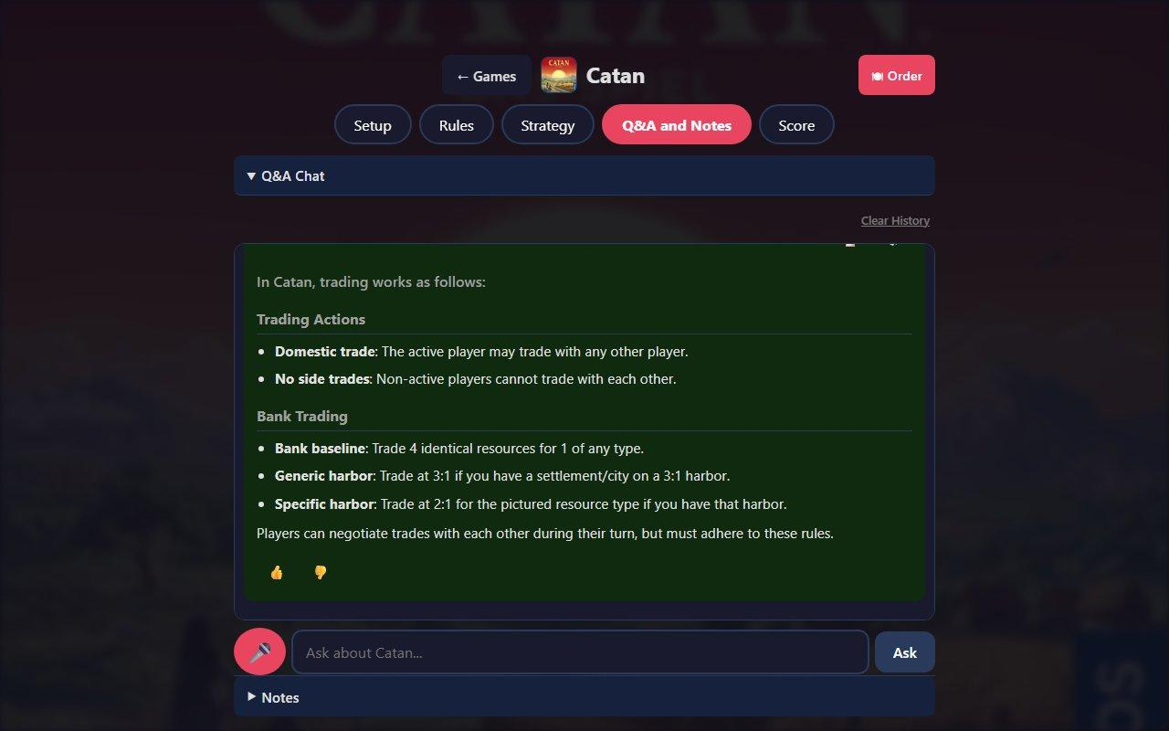
Voice-Guided Game Teaching
Every game has structured guides for Setup, Rules, and Strategy. Each section can be read aloud with text-to-speech at adjustable speeds. Multiple players at the same table follow along on their own phones.
Setup Guide with Voice Playback
AI Q&A for Mid-Game Questions
GameMaster Guide | playgmai.com | tim@playgmg.com
4

Slide 5
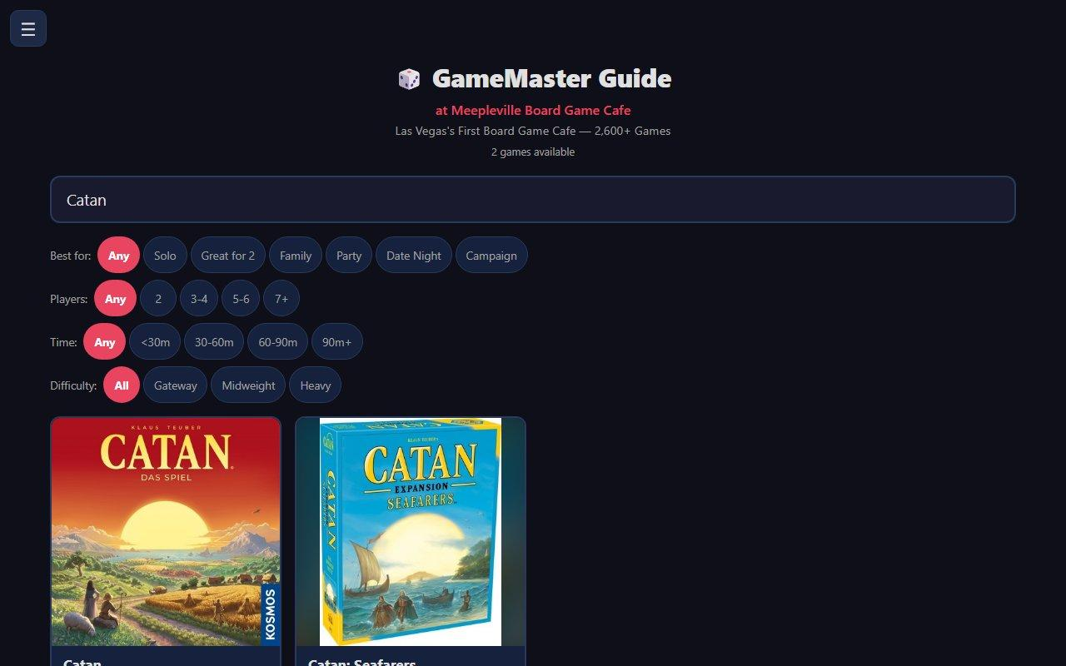
Game Finder
Replace Google Sheets with instant search. Staff and customers type a game name and instantly see if you have it and exactly where it's located on the shelf.
Before: Google Sheets lookup, ask staff, check shelves manually
After: Search on your phone, see shelf location instantly
We import your existing spreadsheet directly. No re-entering data.
GameMaster Guide | playgmai.com | tim@playgmg.com
5

Slide 6
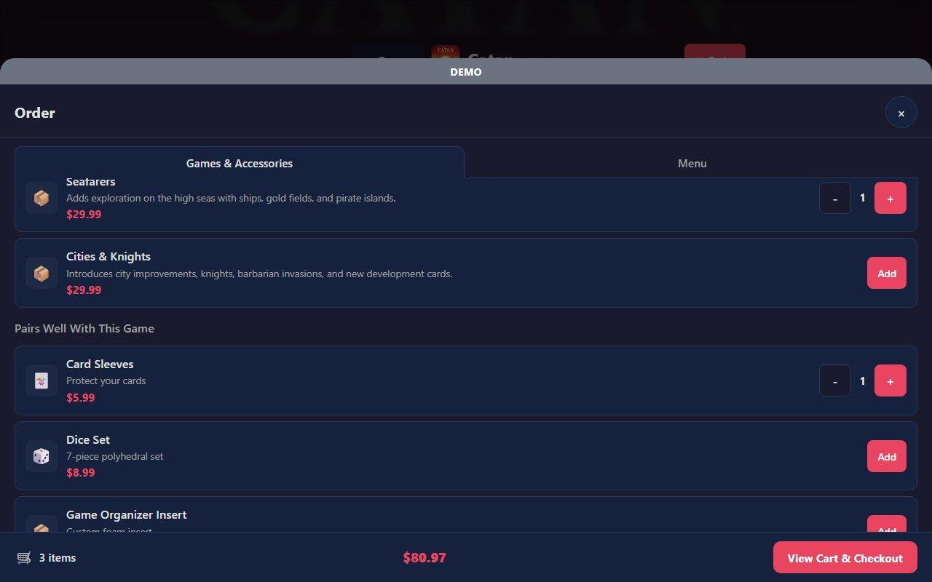
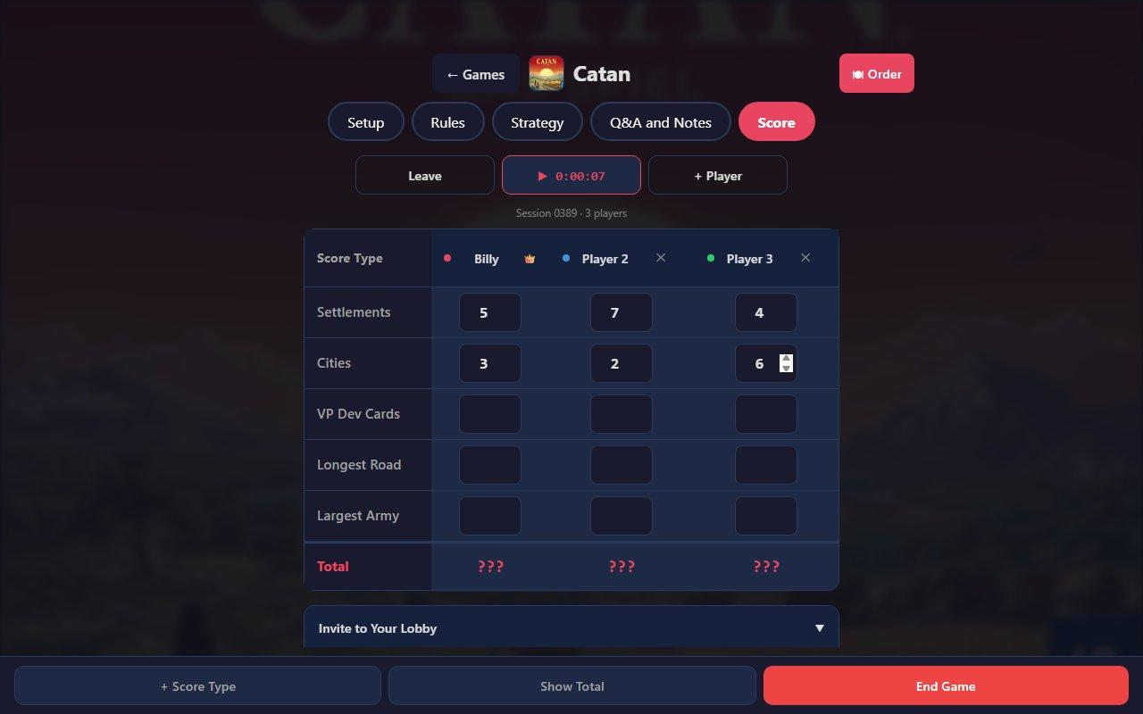
Order Food & Track Scores
Customers order food and drinks from their phone without leaving the game. Staff get notified with the table location for delivery, or customers get a pickup alert.
Game-specific score tracking keeps groups engaged for the full session.
F&B and Game Accessory Ordering
Per-Game Score Tracking with Lobby
GameMaster Guide | playgmai.com | tim@playgmg.com
6

Slide 7
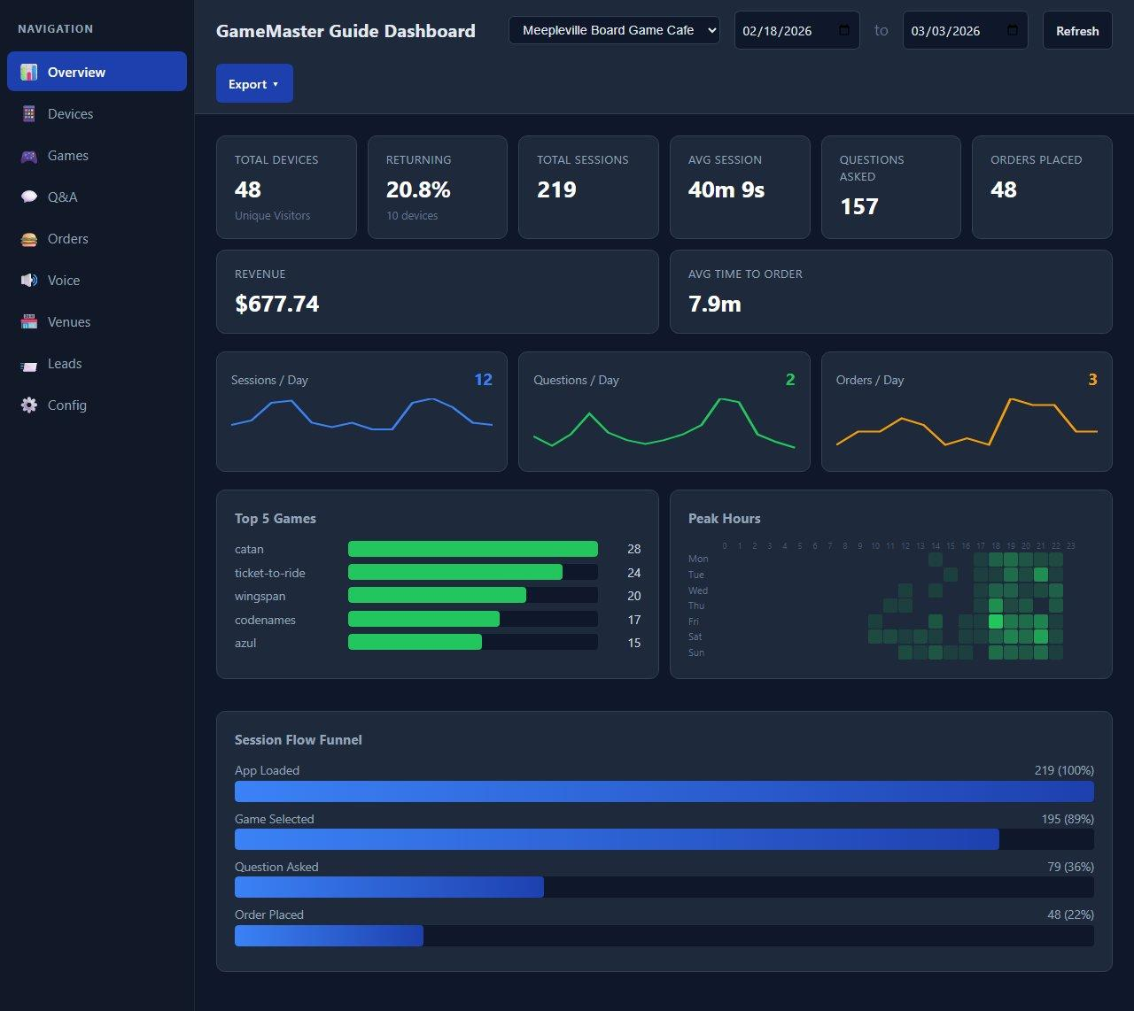
Your Venue Dashboard
See exactly what's happening in your venue.
Sessions
Top games
Peak hours
Orders
Revenue
Customer game questions
All in real time
GameMaster Guide | playgmai.com | tim@playgmg.com
7

Slide 8
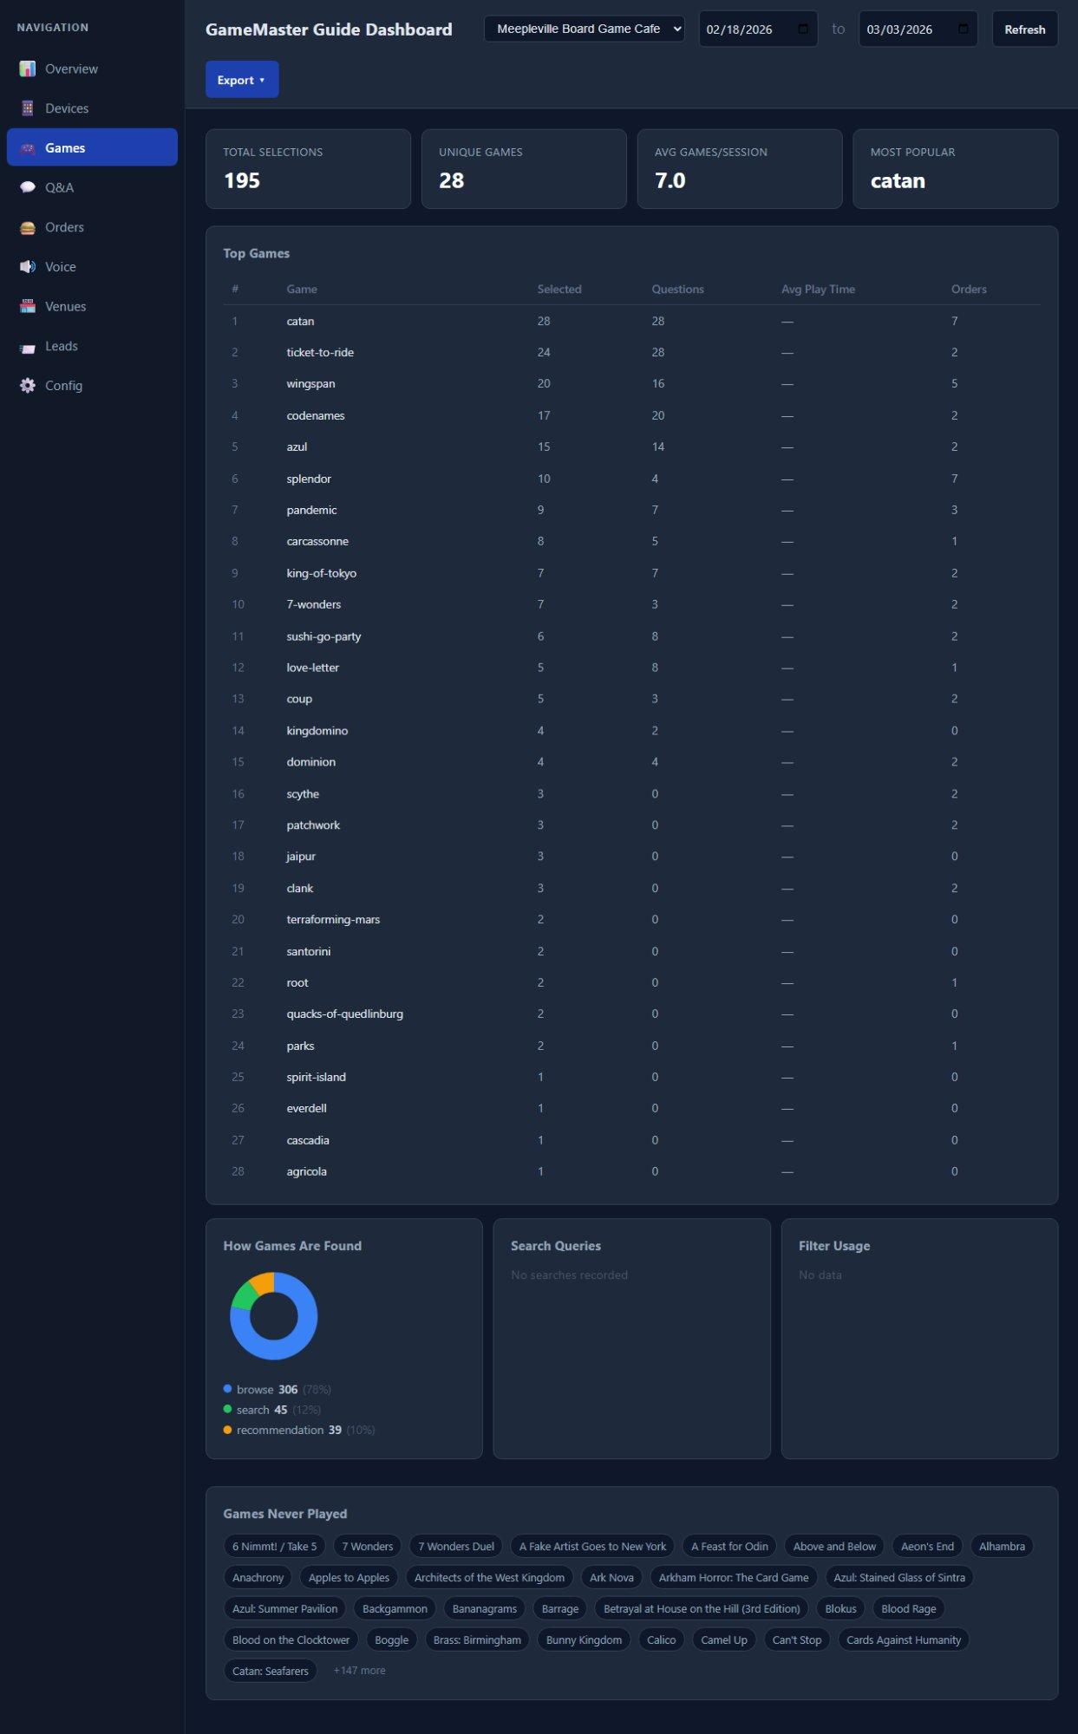
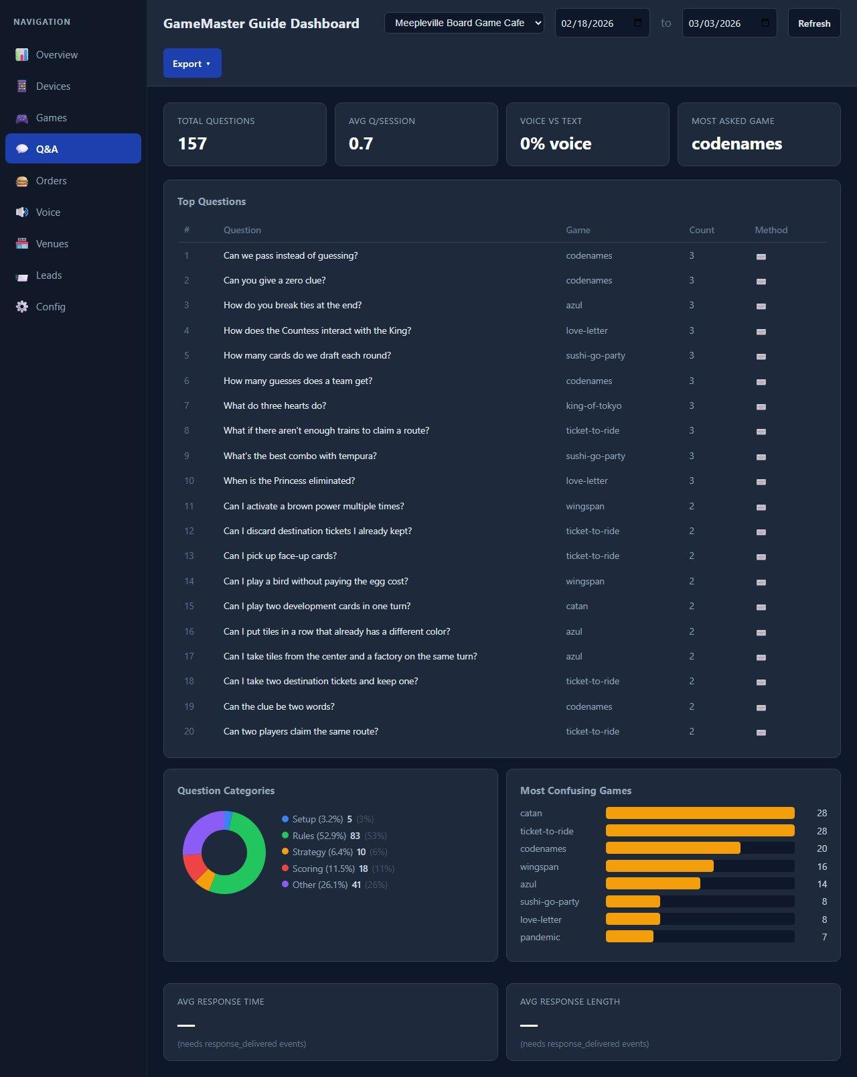
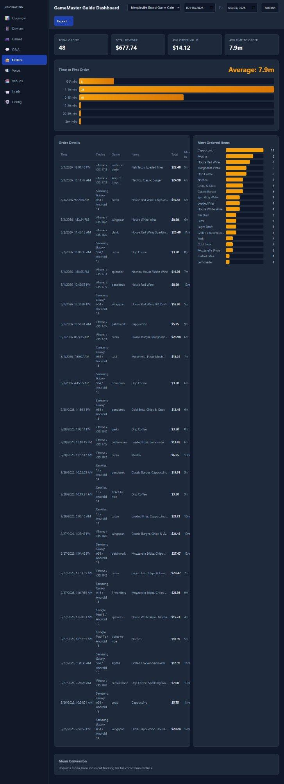
Analytics That Drive Decisions
Game Popularity
Customer Questions
Order Analytics
GameMaster Guide | playgmai.com | tim@playgmg.com
8

Slide 9
30-Day Pilot Plan
Full Premium package. No credit card. No commitment.
Week 1
Onboarding & Game Finder
Mar 16-22
Import your full catalog from Google Sheets. Set up shelf locations. Game teaching live on phones for all 250+ members.
Week 2
Food & Beverage Ordering
Mar 23-29
Menu loaded, ordering live. Customers order from their phones. Pickup notifications or staff table delivery alerts.
Week 3
Optimization
Mar 30 - Apr 5
Review analytics: top games, customer questions, order volume. Fine-tune based on real usage patterns and staff feedback.
Week 4
Results Review
Apr 6-12
Sit down together, walk through the numbers. Impact on operations, staff feedback, customer satisfaction. Discuss next steps.
GameMaster Guide | playgmai.com | tim@playgmg.com
9

Slide 10
What's Included in Your Pilot
✓
Full game library (200+ games)
✓
Weekly additions for high-priority games
✓
Voice-guided game teaching
✓
Score tracking with multiplayer lobby
✓
AI Q&A for mid-game questions
✓
Venue analytics dashboard
✓
Game Finder with shelf locations
✓
Game sales & accessory prompts
✓
CSV import from your Google Sheets
✓
Setup, configuration & tech support
✓
Food & beverage ordering
✓
Multi-device support (unlimited phones)
Cost for the 30-day pilot: $0 No credit card. No auto-renewal. No obligation.
GameMaster Guide | playgmai.com | tim@playgmg.com
10

Slide 11
Try Now
Demo Access
Contact
URL: playgmai.com
Tim Pham
GameMaster Guide
Login: demo@meepleville.com
tim@playgmg.com
Password: gmg2026
(714) 251-6078
Let's get Meepleville set up.

